Slide 1

FITNESS Website Plan
SSCI301
Eng/ Marwa Aldeeb
Team:
Omar Reda 211001265
Yousef akram 211000014
Marwan Maged 211000328

Slide 2
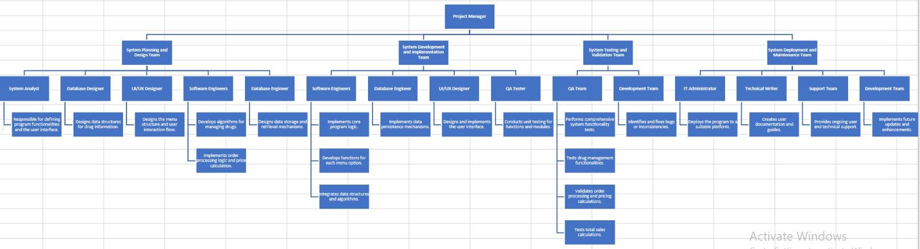

Slide 3
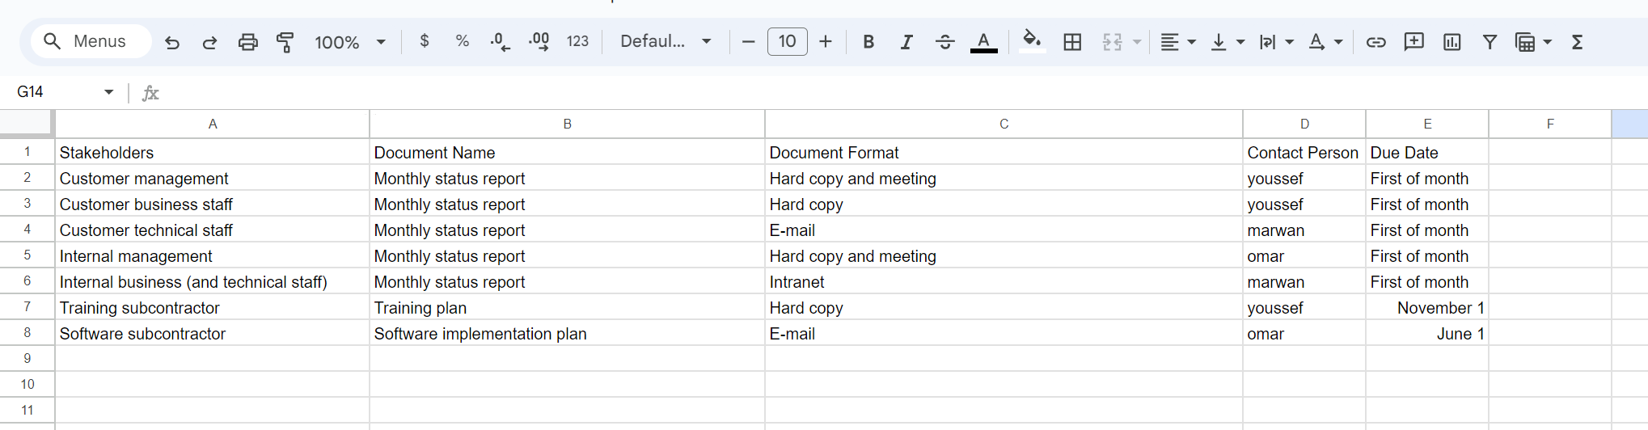
Management plan

Slide 4
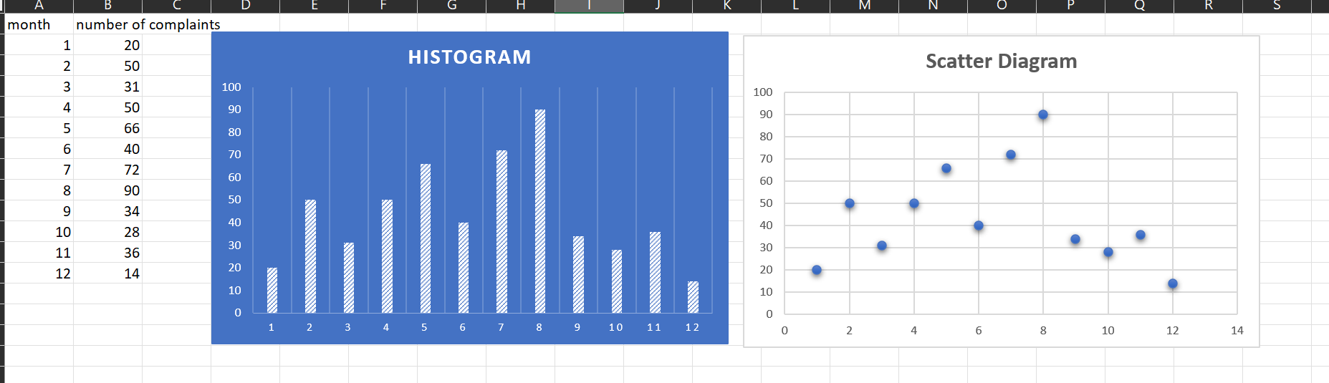

Slide 5
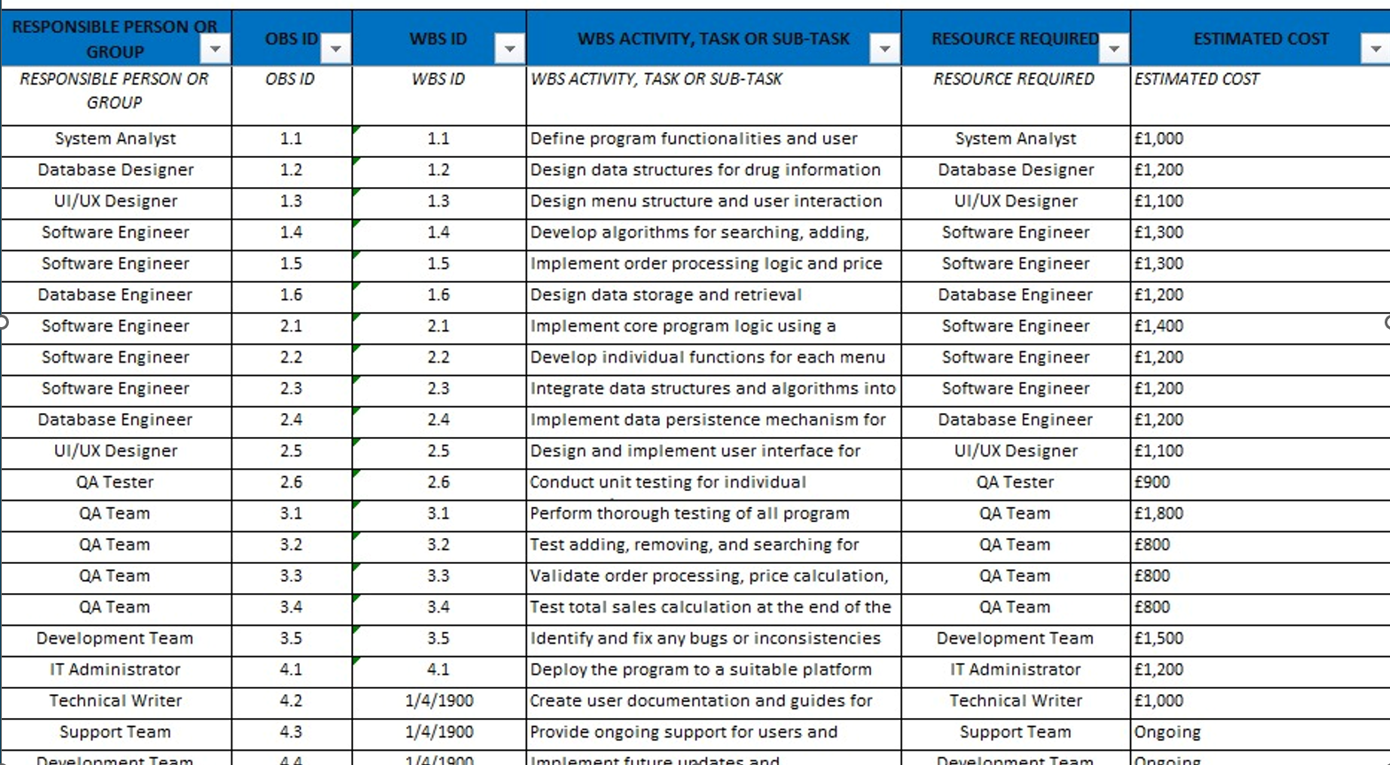
OBS

Slide 6
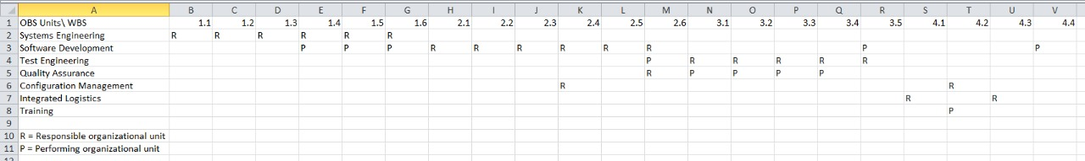
RAM

Slide 7
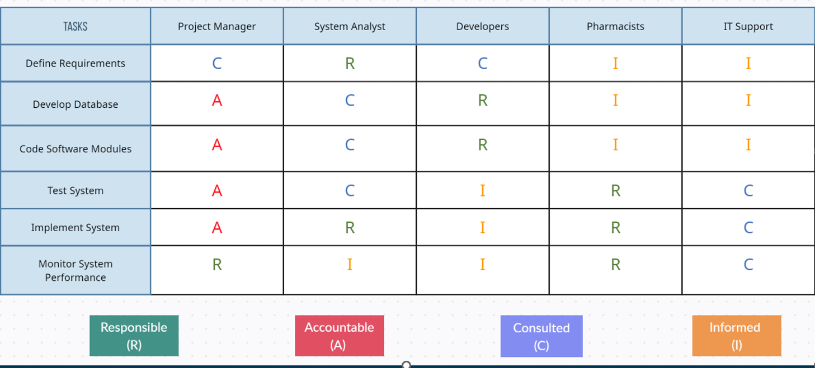
RACI
Coach
coach

Slide 8
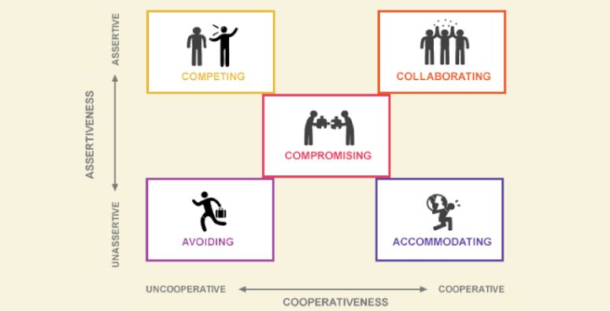
Conflict Handling

Slide 9
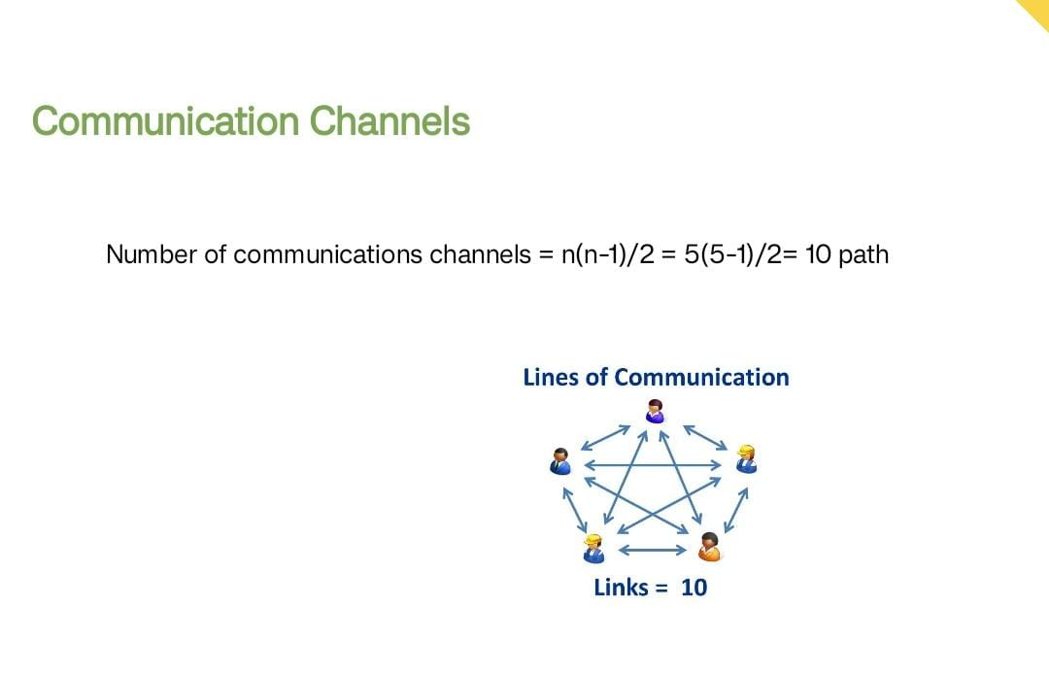
Team meetings are conducted regularly, fostering discussions on project progress and issue resolution, promoting collaboration through in-person or virtual platforms. Email serves as a formal communication tool for document sharing, seeking approvals, and maintaining a record. Project management software like Asana or Trello centralizes communication, aiding collaboration, task assignments, and progress tracking. Instant messaging platforms such as Slack facilitate quick, informal communication among team members. Stakeholder meetings engage pharmacy staff and regulatory bodies for feedback and updates related to the pharmacy management system. Progress reports are regularly prepared, sharing project status and milestones with stakeholders. Comprehensive documentation, including project plans and risk registers, is maintained and shared for transparency and effective communication. 3(3-1)/2=3

Slide 10
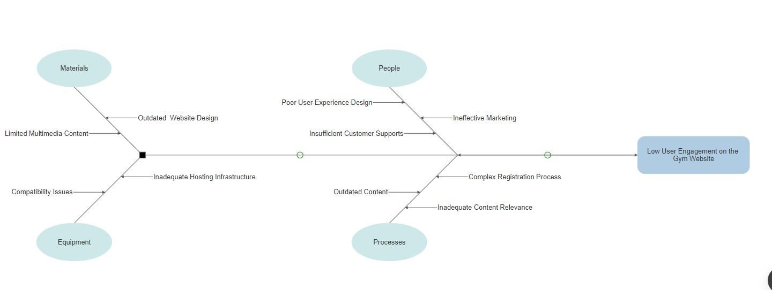
cause and effects diagram

Slide 11
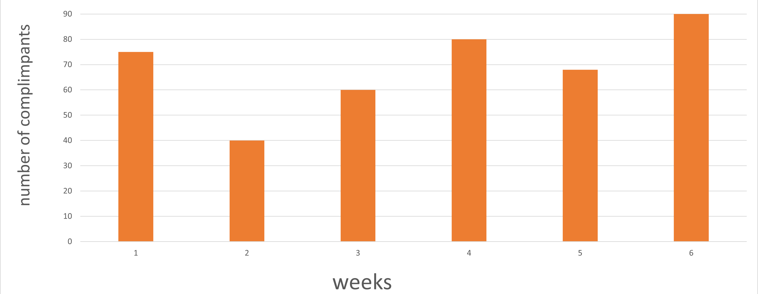
complaints chart

Slide 12
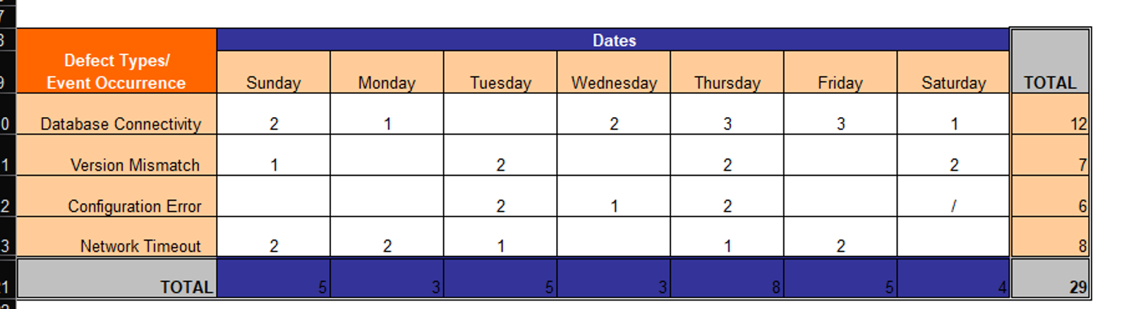
Defects Chart

Slide 13
Presentation link
https://drive.google.com/file/d/1C7YiKHAuUrgQXAB2737-nMQV0lw1zYs4/view?usp=sharing

Slide 14


Thank you

